Slide 1
Ticketless entry to Monuments/Museums
Prepared by 21CS024,Drashti Mahyavanshi
21CS032,Mahima Mehta
21CS033,Vrushali Mhaskar

Slide 2
Table of Content
01 | Introduction
02 | Problem Statement
03 | UI/UX Design
04 | Content
05 | Functionality
06 | Performance
07 | Security

Slide 3
Problem Statement
An e-ticket (electronic ticket) is a paperless electronic document used for ticketing. It can help in better crowd management of museums/heritage sites.
The prediction of the expected crowd should be added as a feature. It reduces booking expenses by eliminating the need for printing and mailing paper documents.
Can help in keeping a better record of visitors. Can improve sales as a visitor can book, purchase and print out the electronic ticket any time 24 hours a day."

Slide 4
Functional and Non-Functional Requirement
Functional Requirements :
Admin Requirements
End User Requirements
System Requirements
Non Functional Requirements:
Database Security
Availability
Efficiency Requirements
Reservation Requirements

Slide 5
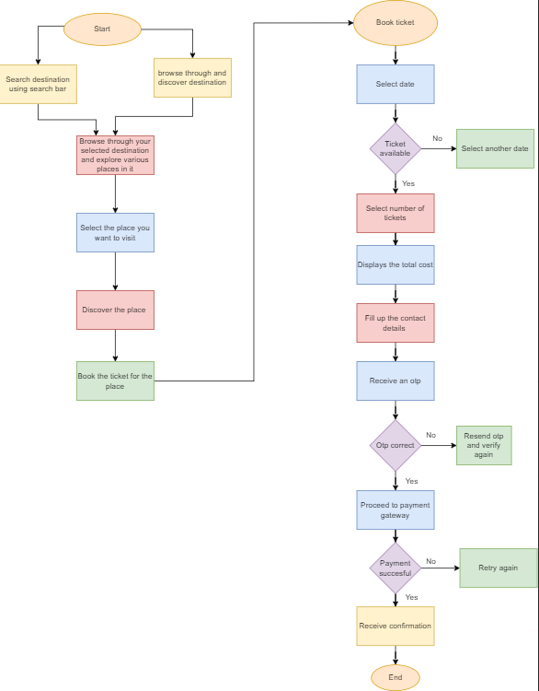
Flow-chart of the System

Slide 6
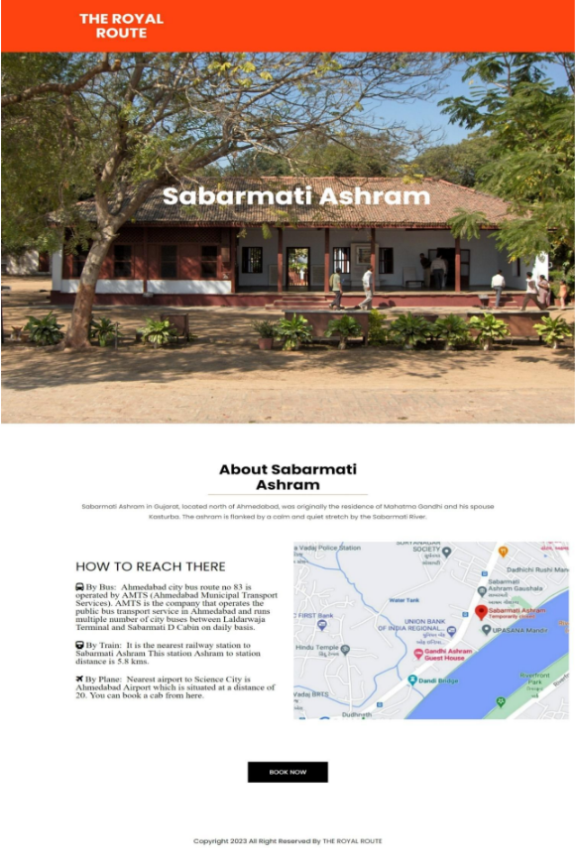
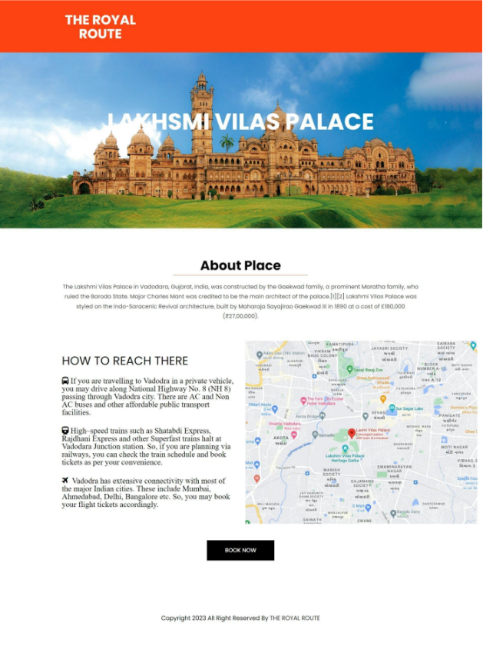
Design and Development Process

Slide 7
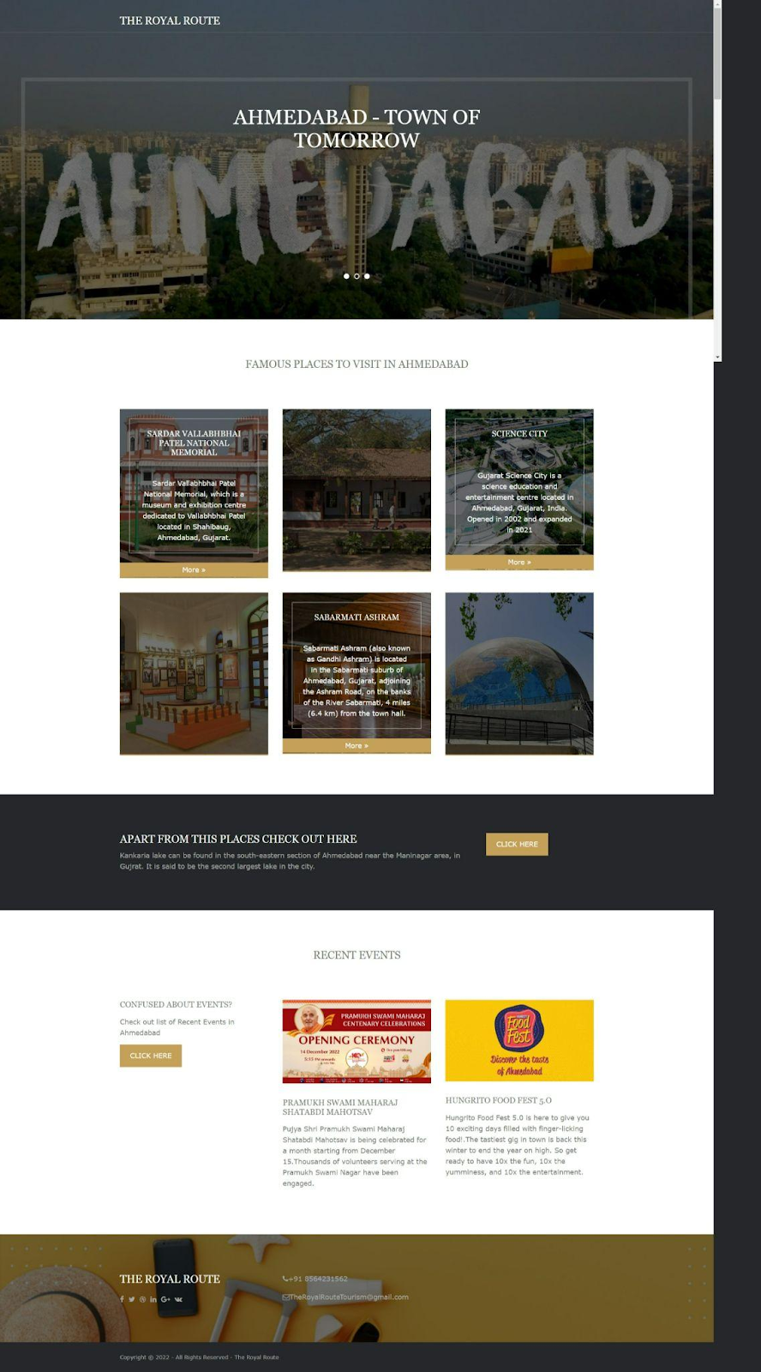
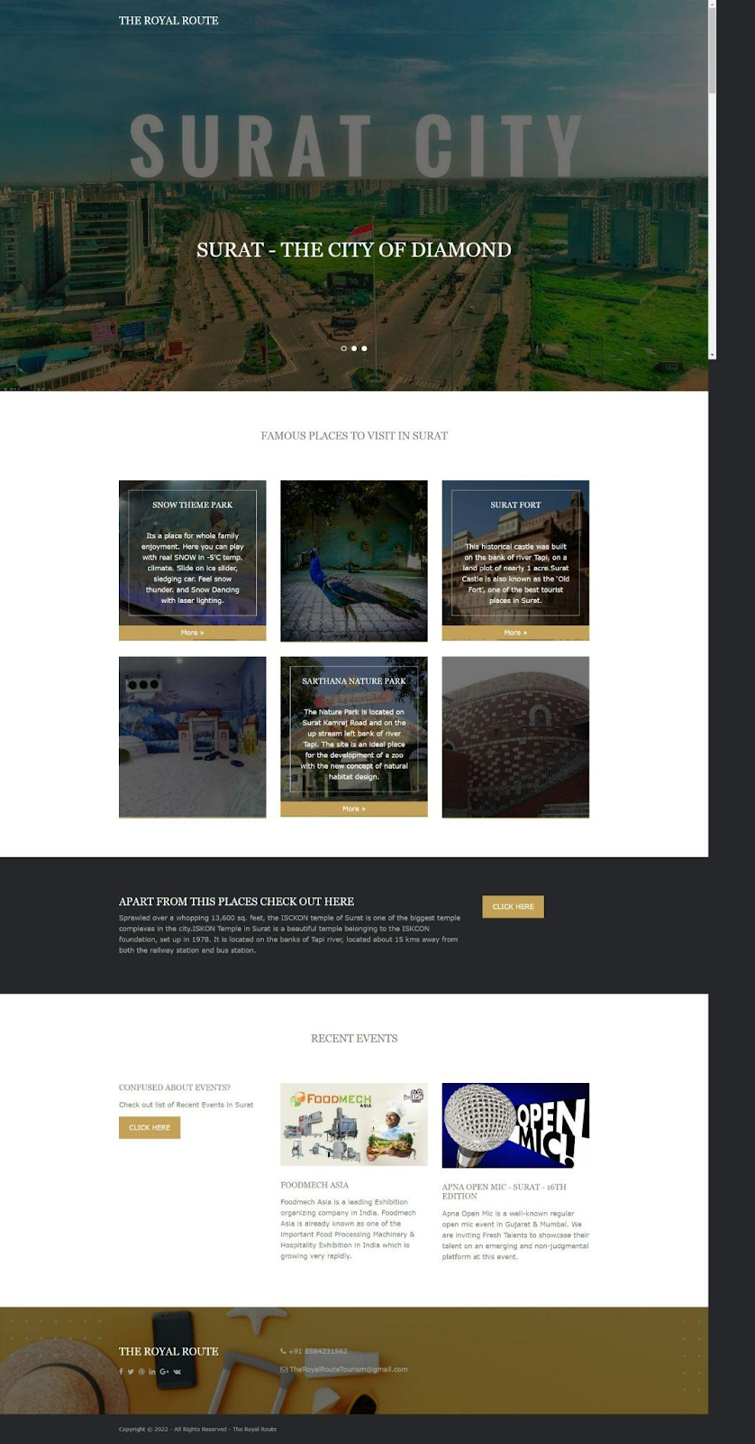
Design and Development Process

Slide 8


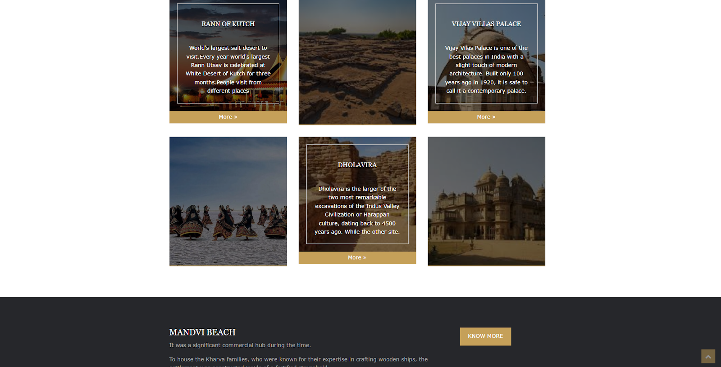
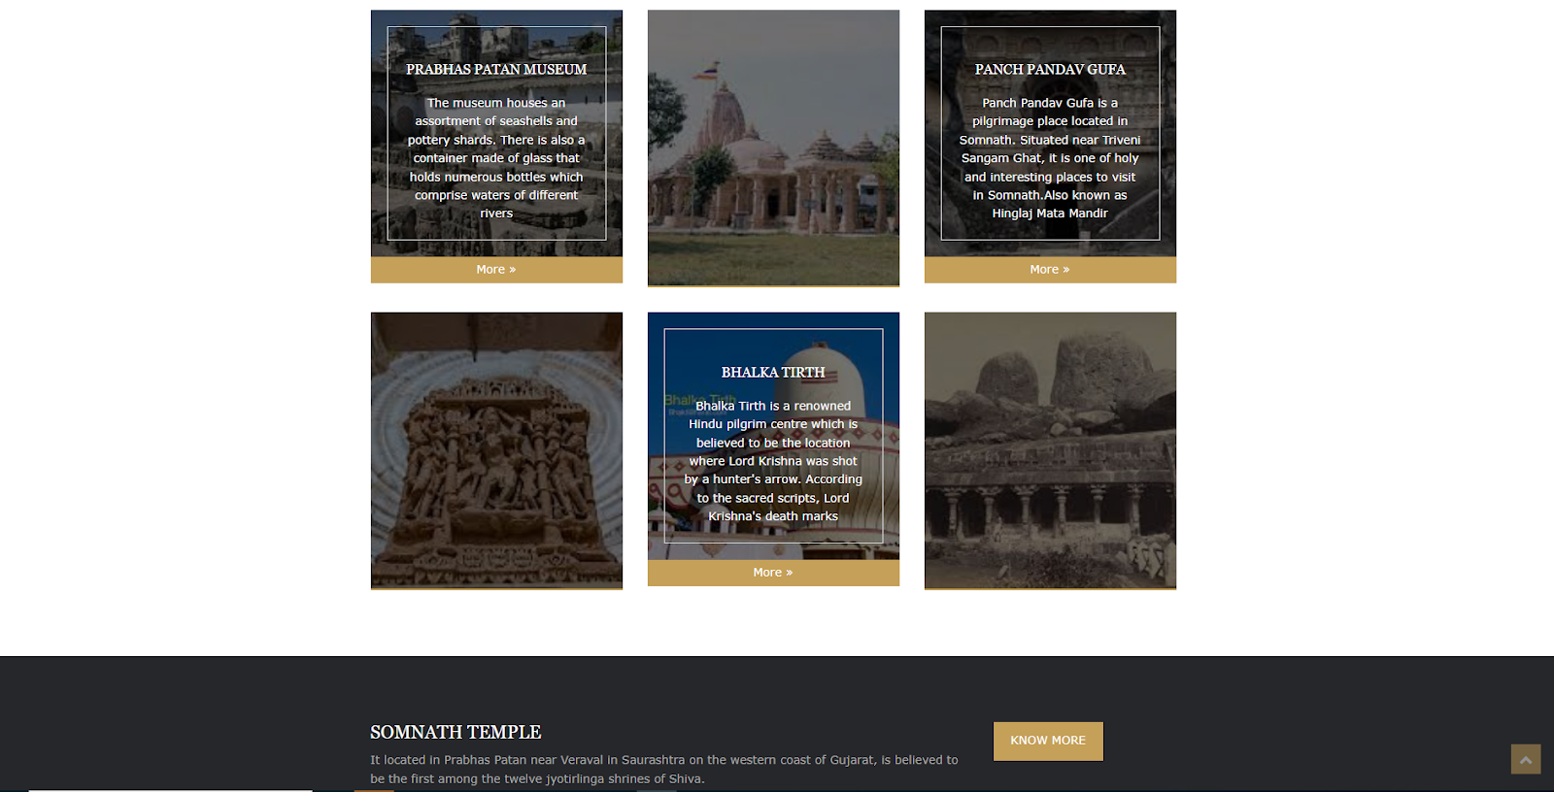
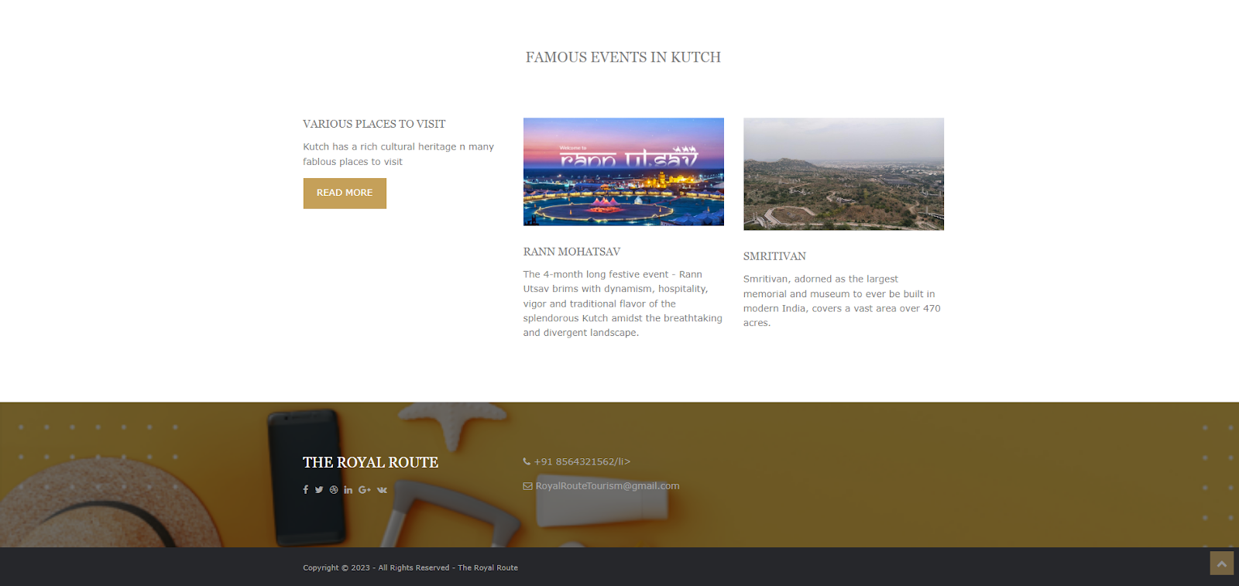
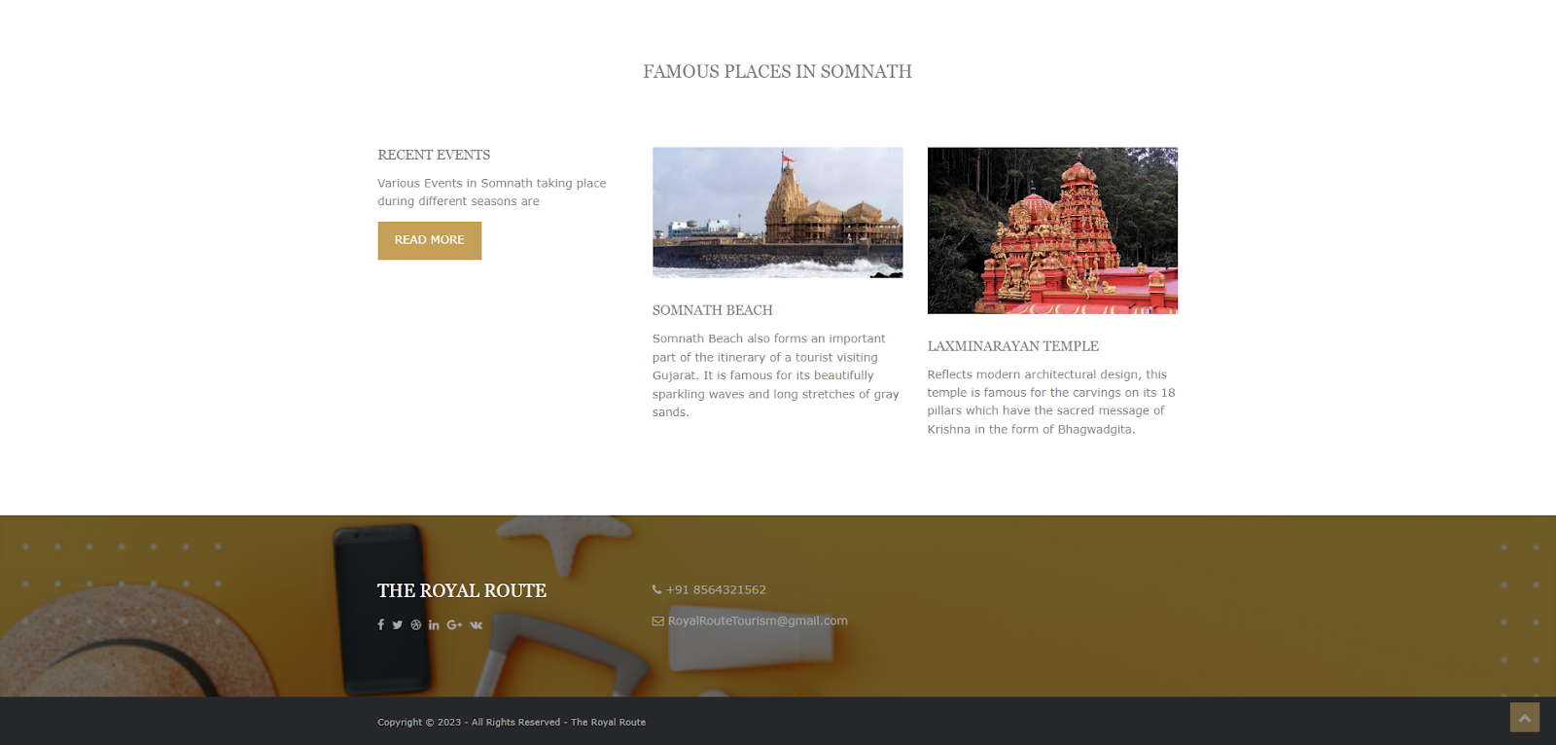
Design and Development Process

Slide 9
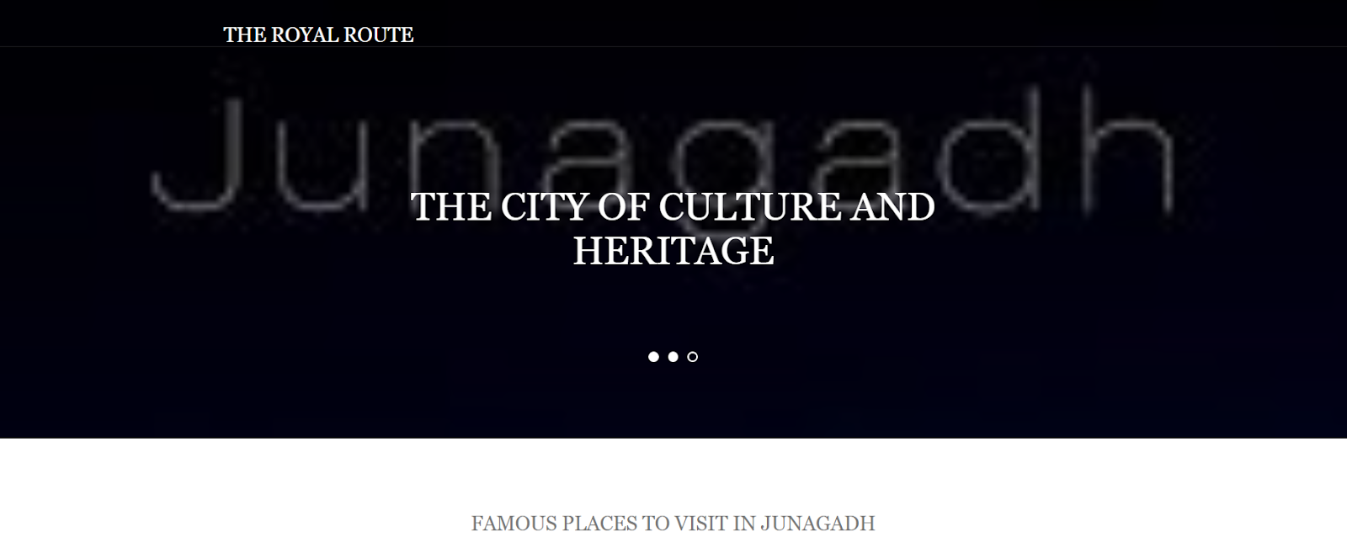

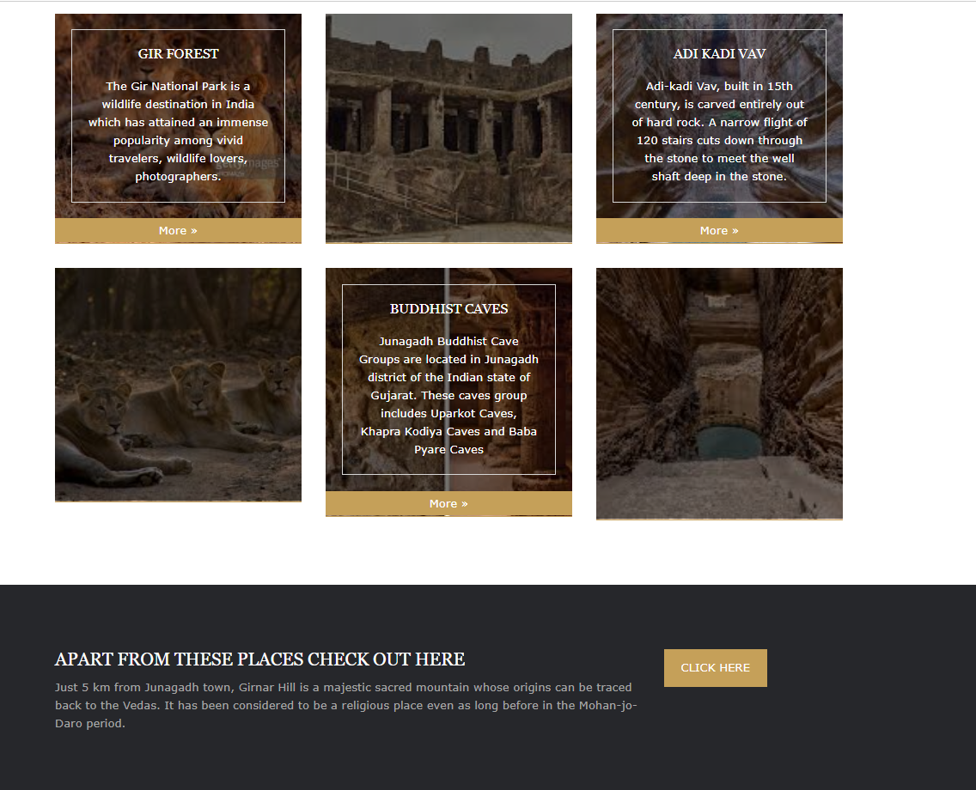
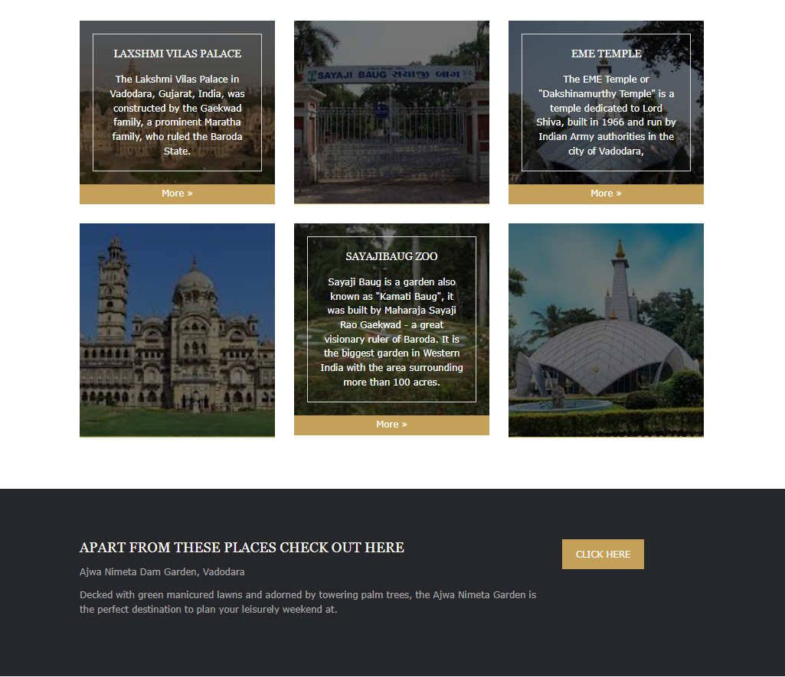
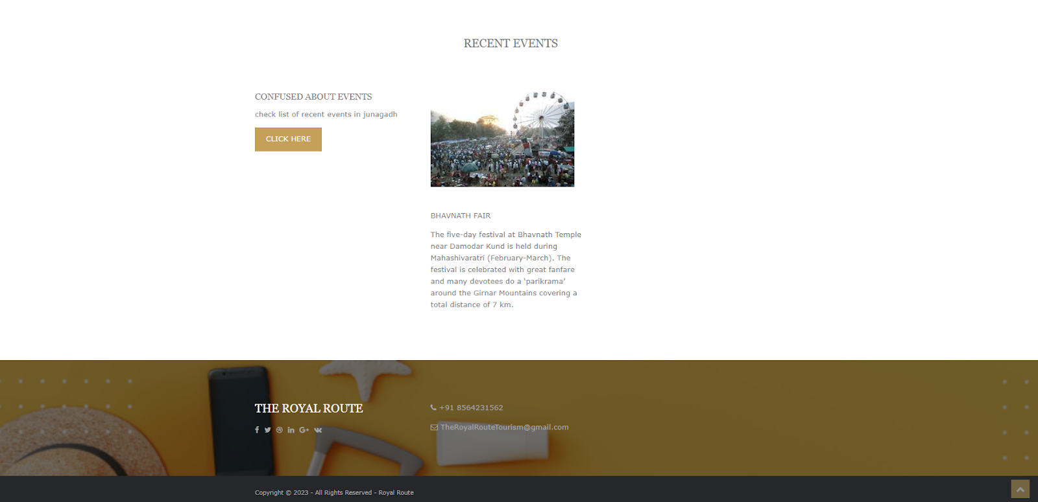
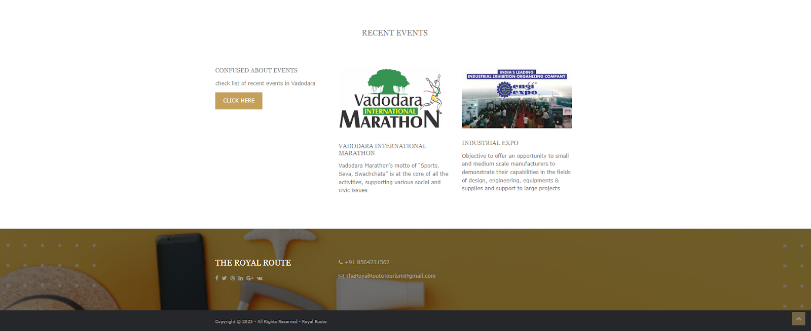
Design and Development Process

Slide 10
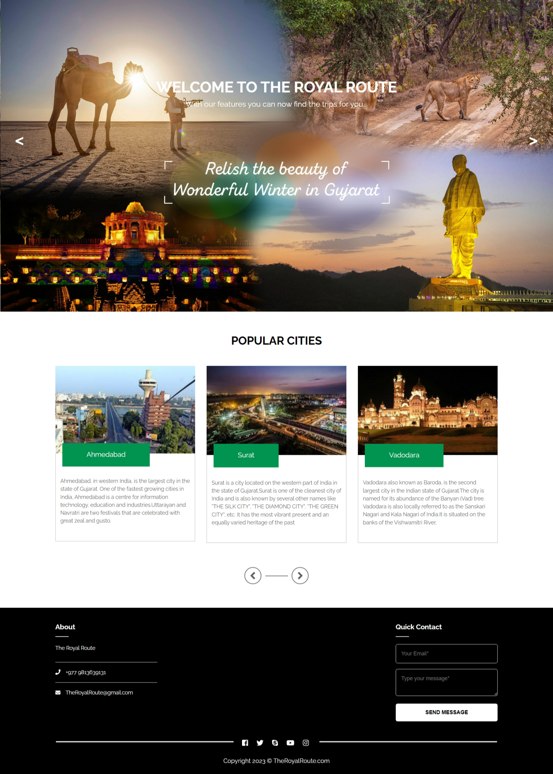
Design and Development Process

